Slide 1
Project Plan
By: Cole Schumacher, Greg Wendt, Maxwell Wangler, Nick Mitchell, Sam Henley, and Tristan Duyvejonck

Slide 2
Technical Goals
Develop a system that monitors Control Flow Integrity
Use race conditions
Implement logic in FPGA
Notes:
Our main technical goal is to develop a system for monitoring the Control Flow Integrity of a process. The system will match some known token to a token generated during execution. If the strings do not match within a certain tolerance, it is determined that there is a breach in control flow integrity. We want to use race conditions logic to match the strings to decrease the response time. After a solution is developed and tested, the logic will be implemented in an FPGA.

Slide 3
Conceptual Sketches
Notes:
Compute Nodes - Maxwell

Slide 4
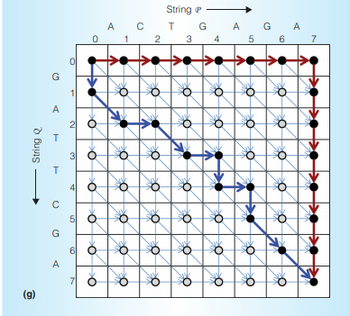
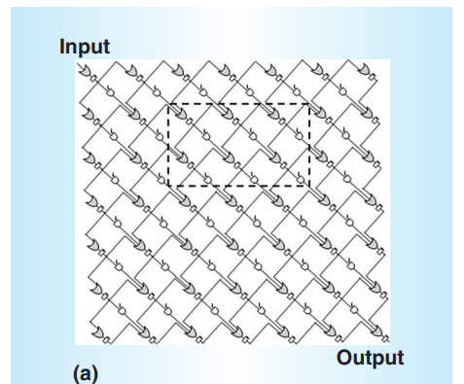
Conceptual cont.

Slide 5
Timeline Walkthrough
Ideate solutions: October 26, 2020
Test solution in higher-level programming language: November 20, 2020
Implement race conditions logic : February 12, 2021
Implement solution in FPGA: April 30, 2021
Notes:
Cole
Understand the problem
Ideate solutions
Test solutions in higher-level programming language
Implement race conditions logic
Implement solution in FPGA

