Slide 1
Technical Challenges
By: Cole Schumacher, Greg Wendt, Maxwell Wangler, Nick Mitchell, Sam Henley, and Tristan Duyvejonck
Notes:
Greg will introduce again

Slide 2
Understanding the Problem at Hand
Before beginning this project, our team had little/no experience with control flow integrity, race logic, dynamic programming, or FPGA boards.
Our first hurdle was understanding the technology and standards we were working with so that we could solve the problem.

Slide 3
What We Did
Create a pseudo code of the 2D array algorithm
Building from what we understand with the client
Creating a groundwork for the rest of our project
Consistent meetings with clients.
Bringing multiple thought out questions to clients.
Discussions
Continually asking for more clarification on our deliverables

Slide 4
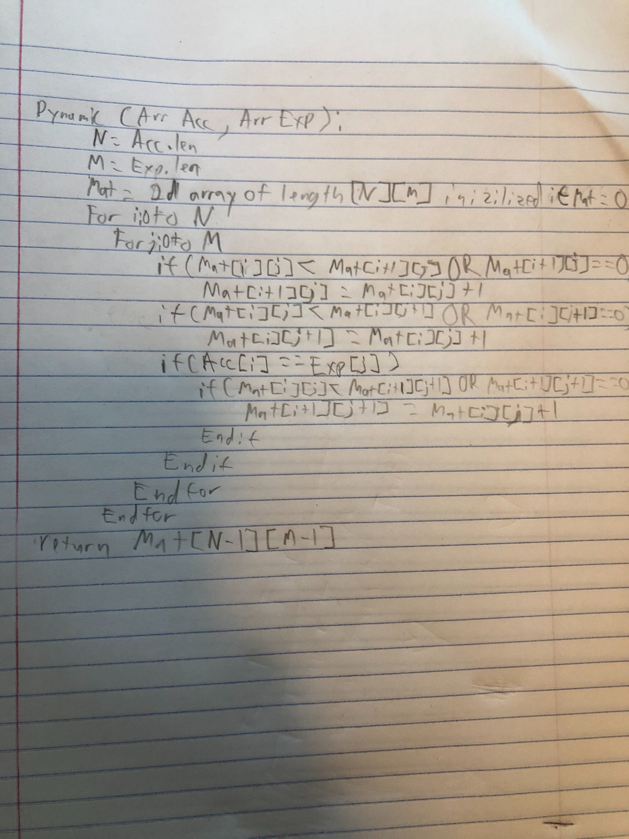
The Algorithm
Process of creating
Broke the problem down into steps
Analysed how those steps would have to connect to one another
Thought about edge cases that would cause the algorithm to fail
Ran a time analysis on the created pseudocode
What it does
It assigns a value based on how different two arrays are using dynamic programming
Notes:
Read by Max

Slide 5
Moving Forward
Continue close and consistent contact with clients.
Weekly meetings with clients consisting of asking questions and receiving clarification.
Continue researching and digging deeper.
Research important topics for our project such as LLVM compilers and CFG.
Dig deeper in how our project can be translated to an FPGA board.

